Slide 1

BEVERAGE TRENDS IN THE US
Prajwal Kumar Hemmakki Rathnakar

Slide 2

MOTIVATION/ BUSINESS CONTEXT
Tea and coffee consumption is important to people’s diets and lifestyles worldwide. They are widely believed to be addictive and hazardous to health when taken in large quantities.
According to surveys, 76% of Americans drink coffee or tea. We want to determine which beverage is more popular and sold in U.S. retail establishments.

Slide 3

DATA DESCRIPTION
DATA DESCRIPTION
Source: https://www.kaggle.com/datasets/dsfelix/us-stores-sales
File Type: CSV
No. of rows: 4249
The dataset contains statistical information about Sales Values in Dollars of American Stores in all 4 markets (East, West, Central, and South).
This dataset is taken for 2010 and 2011 and contains the details for all 4 quarters.
The Product contains different types of beverages such as coffee and tea sold over 2 years in the US market.
The dataset contains different states which are categorized into market sizes.

Slide 4
RESEARCH QUESTIONS
Sneha: What is the relation between profit and sales among markets of product types?
Himaja: What is the gap between budget sales and sales monthly basis?
Manaswi: Which are the top five states profit-wise? And show their profit with product type.
Priya: How are the Marketing, Sales, Product, and Product Types Related
Shrisha: How is the Expenses and Profit related to the Market for Product Types
Prajwal: What is the relation between Inventory, Sales, Product type, and Market Size

Slide 5
DATA PREPARATION
Normalization of available dataset
For analysis, we have considered Product Type as coffee and tea only
Subtypes such as herbal tea and espresso was not considered separate product categories
Using Timestamps: We have considered month and year as separate columns

Slide 6

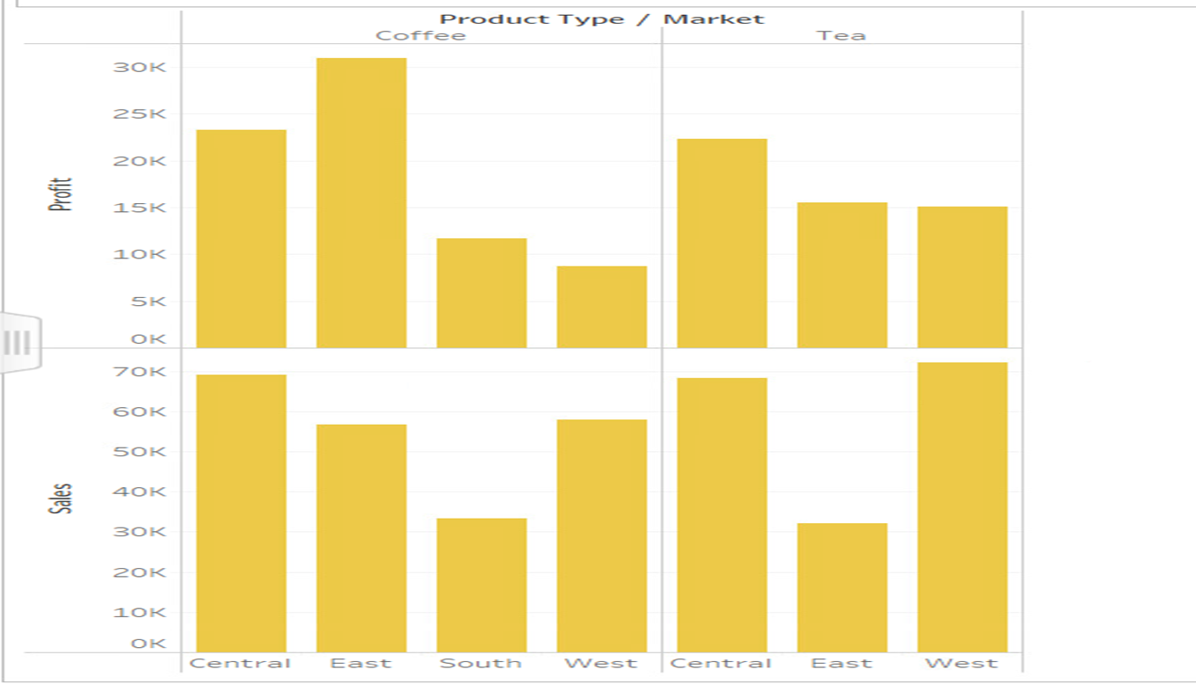
SNEHA :
WHAT IS THE RELATION BETWEEN PROFIT AND SALES AMONG MARKETS OF PRODUCT TYPES?

Slide 7
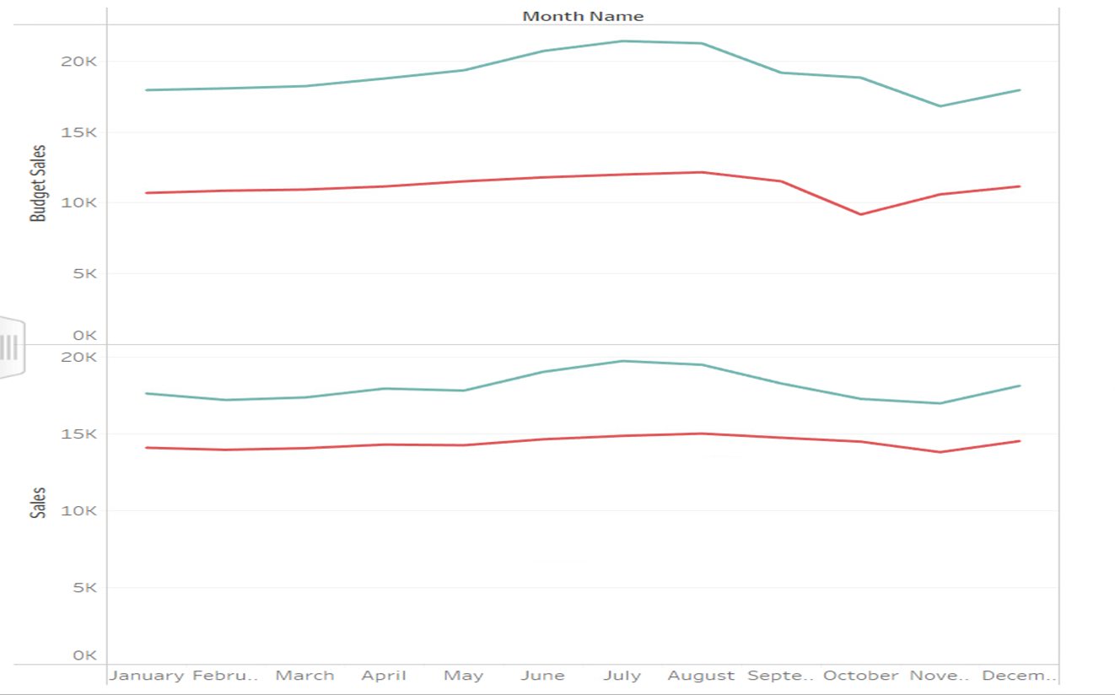
HIMAJA:
WHAT IS THE GAP BETWEEN BUDGET SALES AND SALES MONTHLY BASIS?

Slide 8
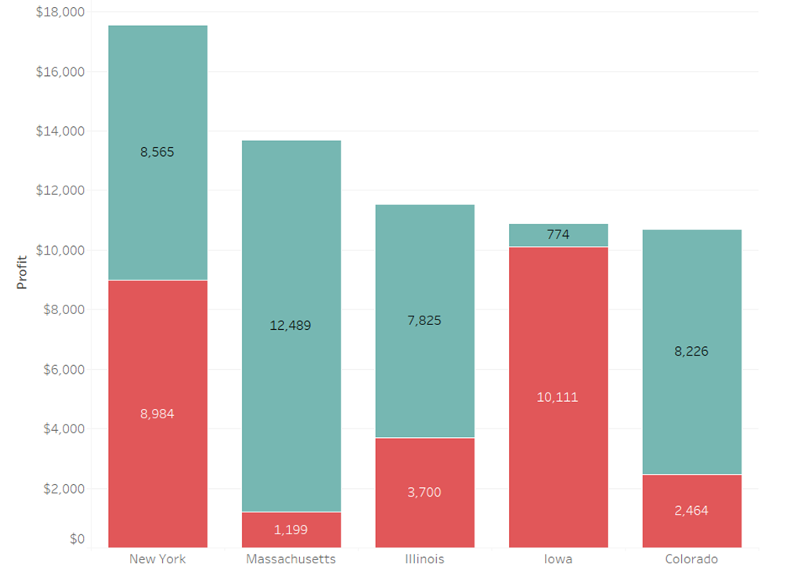
MANSWI:
WHICH ARE THE TOP FIVE STATES PROFIT-WISE? AND SHOW THEIR PROFIT WITH PRODUCT TYPE?

Slide 9
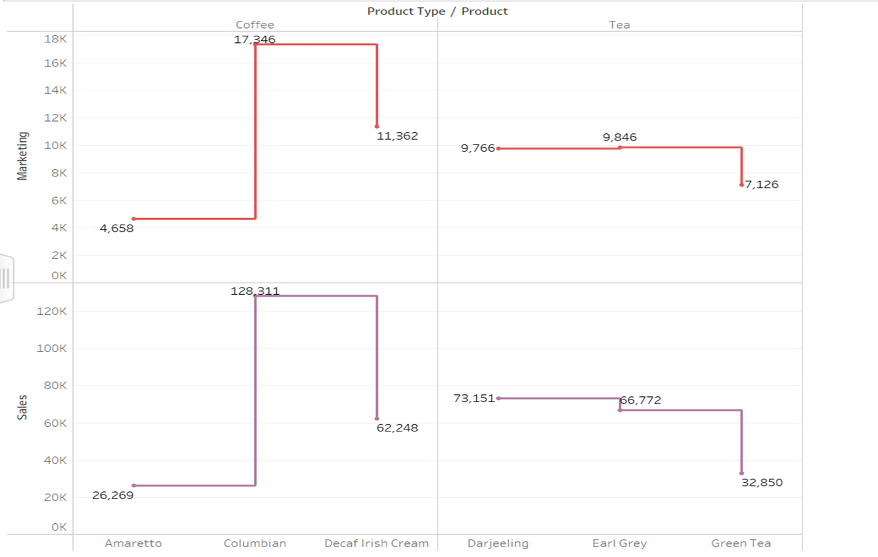
PRIYA:
HOW ARE THE MARKETING, SALES, PRODUCT, AND PRODUCT TYPES RELATED?

Slide 10
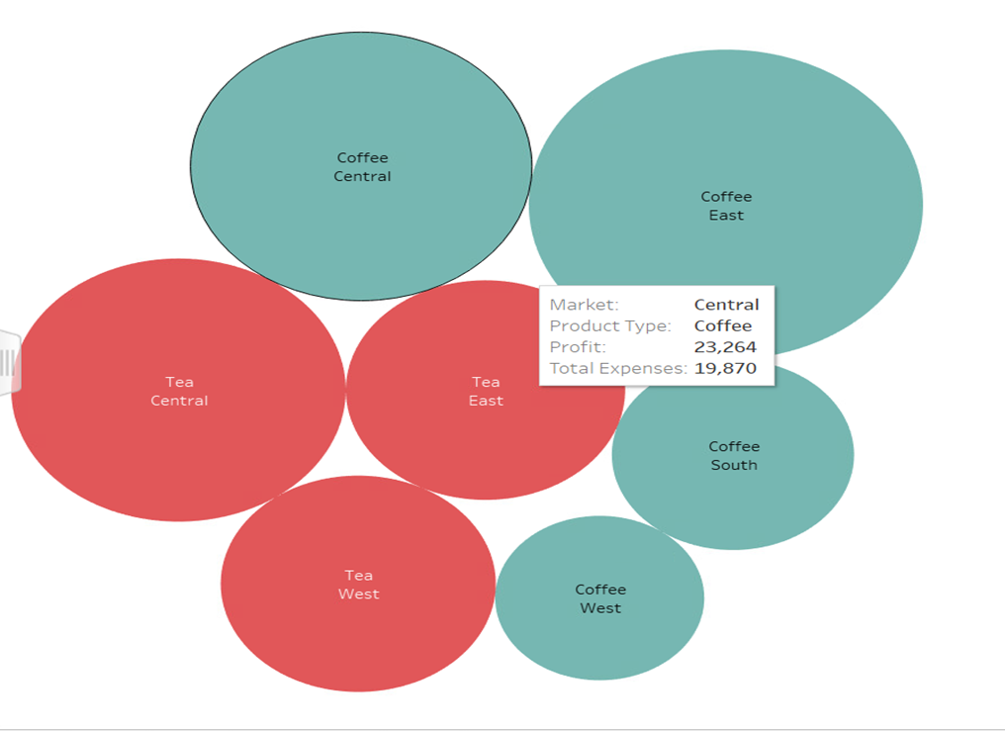
SHRISHA:
HOW ARE THE EXPENSES AND PROFIT RELATED TO THE MARKET FOR PRODUCT TYPES?

Slide 11
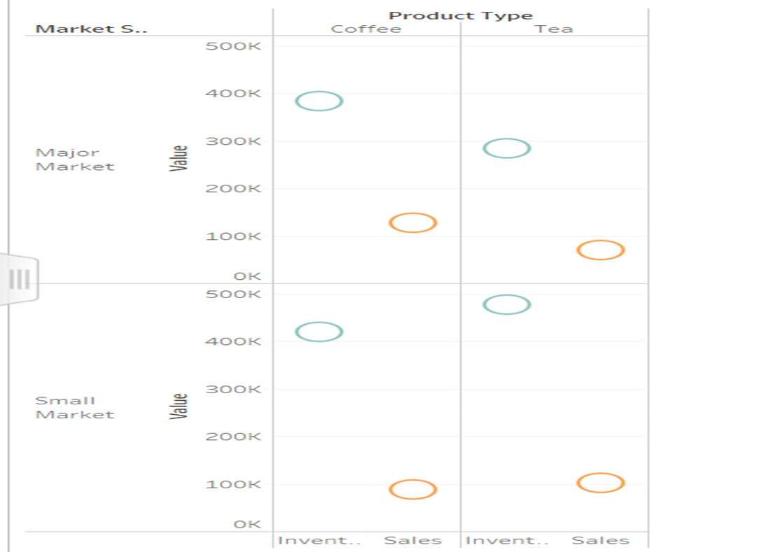
Prajwal:
WHAT IS THE RELATION BETWEEN INVENTORY, SALES, PRODUCT TYPE, AND MARKET SIZE?

Slide 12
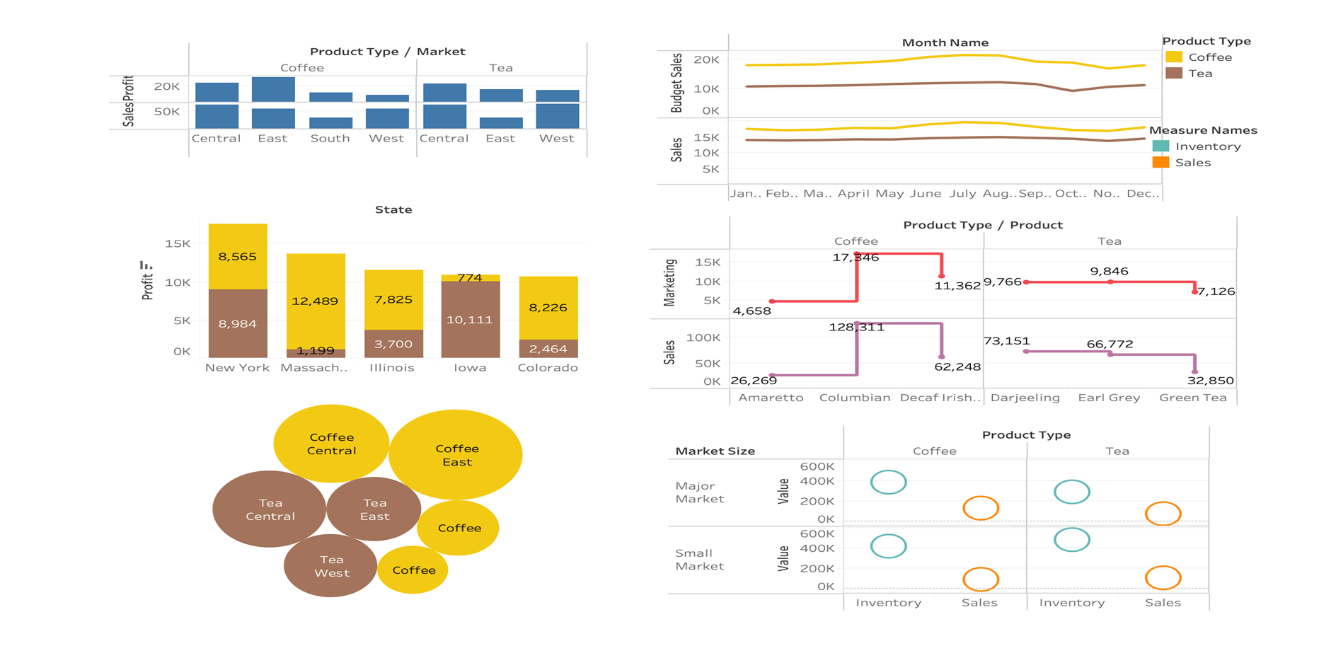
DASHBOARD

Slide 13

LESSONS LEARNED
Data Preparation is Key: Before diving into Tableau, ensure your dataset is clean, organized, and in a format that Tableau can easily interpret. This includes handling missing values, ensuring consistent data types, and removing any irrelevant information.
Understand Data Structure: Familiarize yourself with the structure of your dataset - identify dimensions (categorical data) and measures (quantitative data). Understanding this distinction is crucial for building meaningful visualizations.
Dashboard Creation: Learn to create interactive and visually appealing dashboards that communicate insights effectively to stakeholders.

